Slide 1
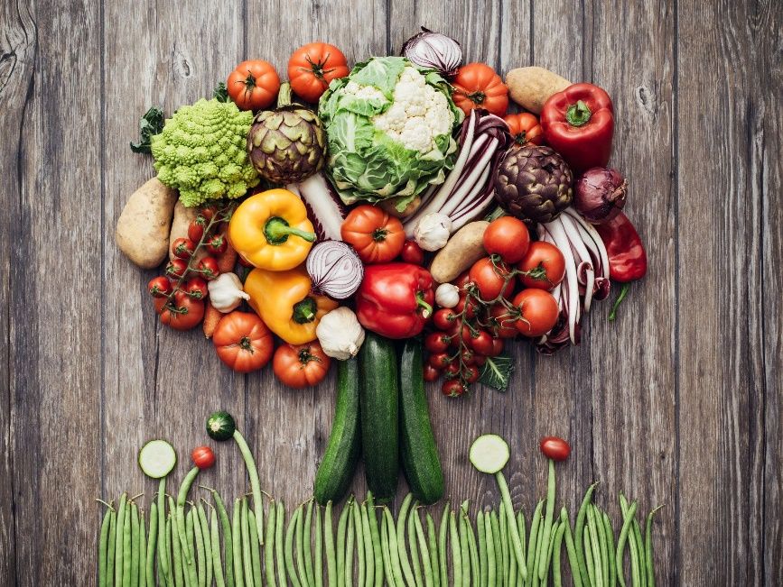
An introduction to a plant- based lifestyle
Dr Ishani Rao, MBBS, BSc

Slide 2
Hello!

Slide 4
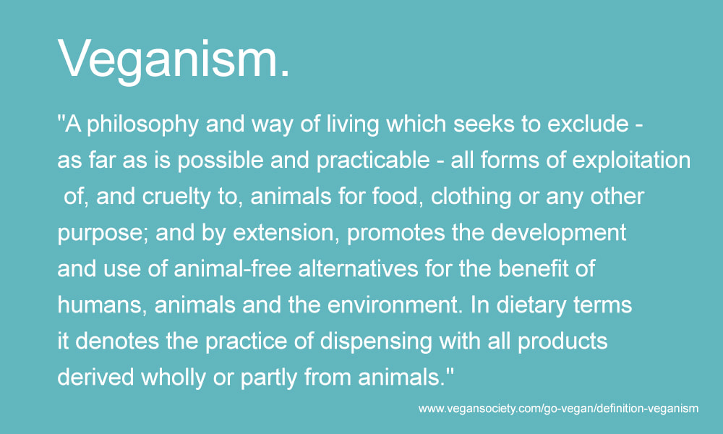

Slide 5
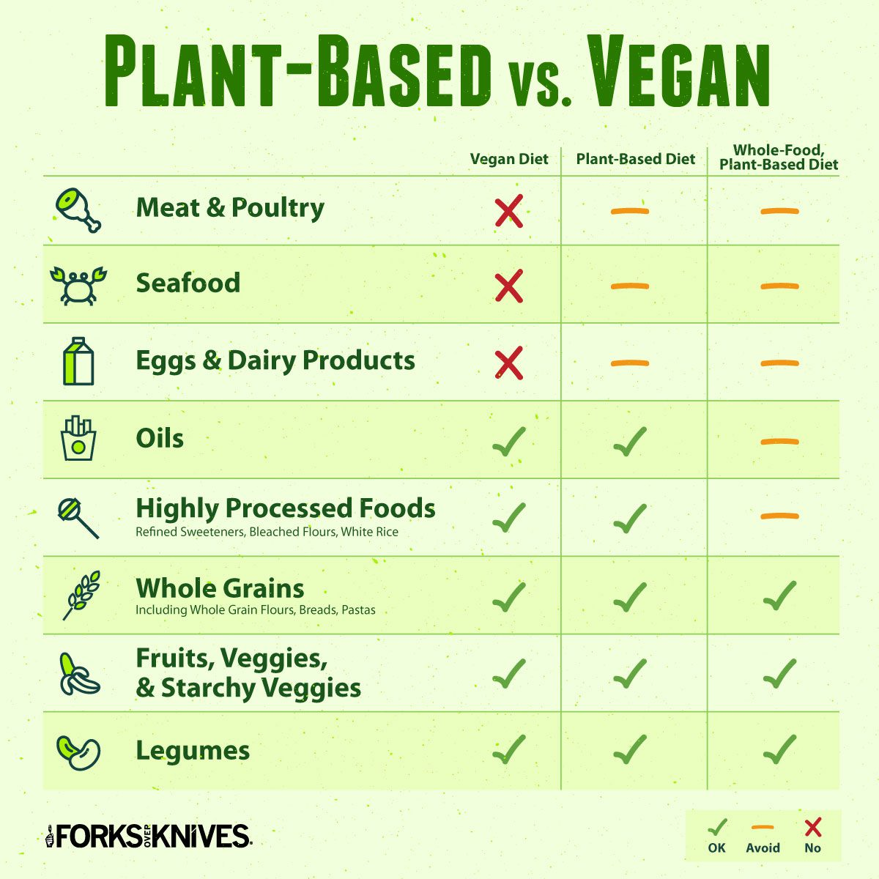

Slide 6
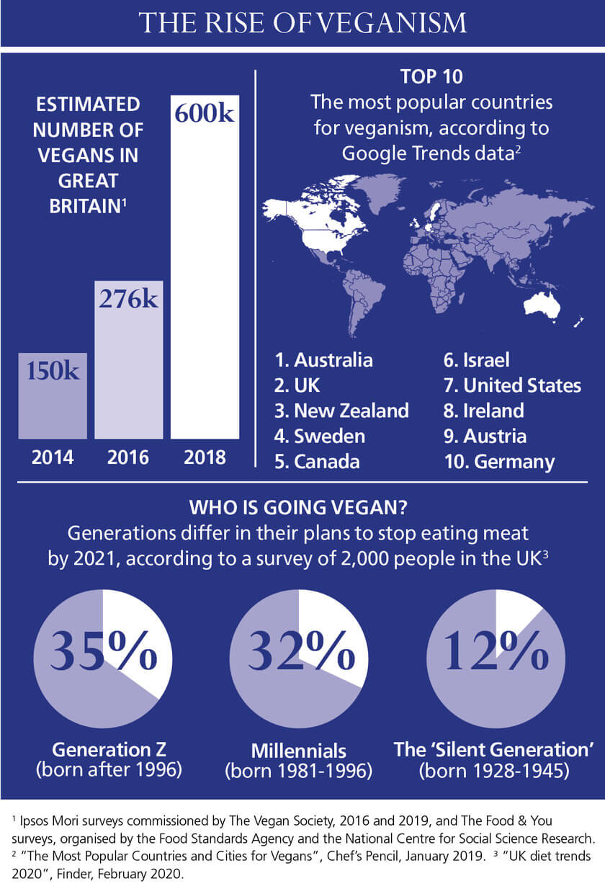

Slide 7
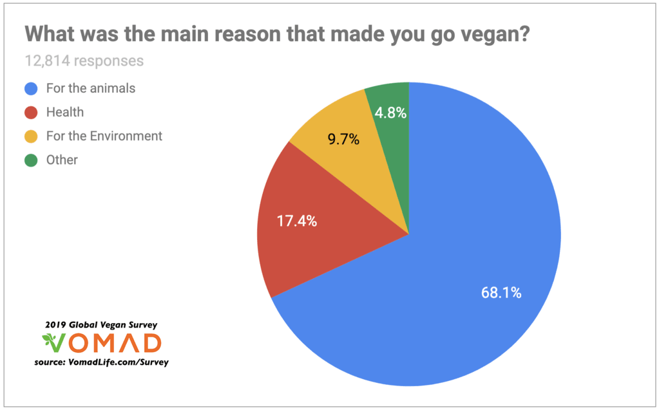

Slide 8
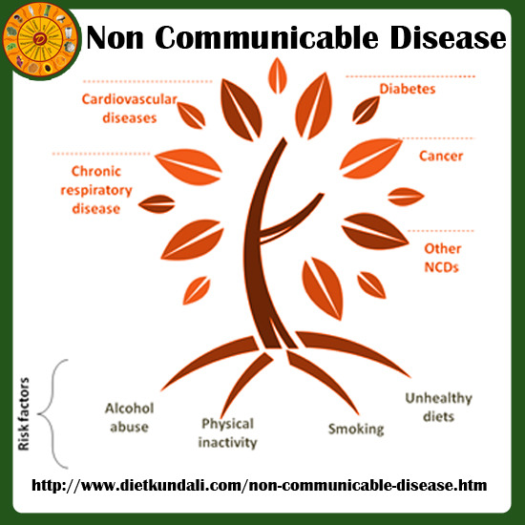
Plant-based diet and physical health
Heart and CV disease causes 1/3 of all deaths in UK at present
Metabolic changes such as raised BP, obesity, hyperglycemia, hyperlipidemia
Diet, physical activity can reduce rates of DM2 by 50%
DM is leading cause of visual loss in the UK
Chronic pain, depression (1/3rd of people with chronic disease), reduced mobility, social isolation
Rapid urbanisation, Western diets, ageing population

Slide 9
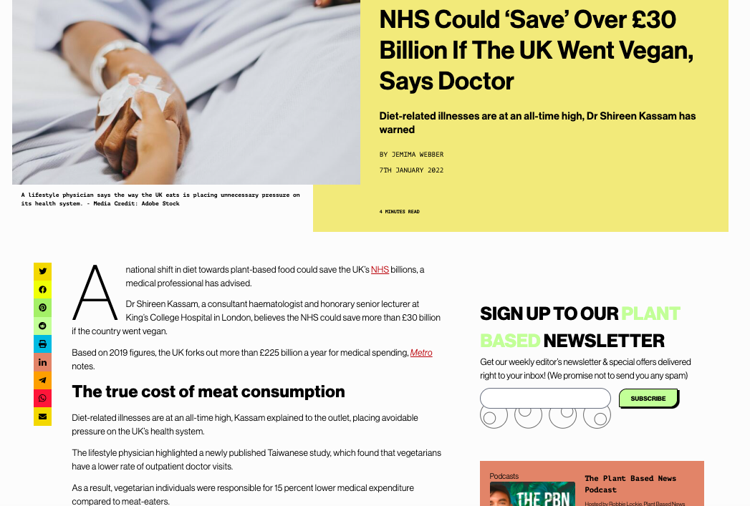

Slide 10
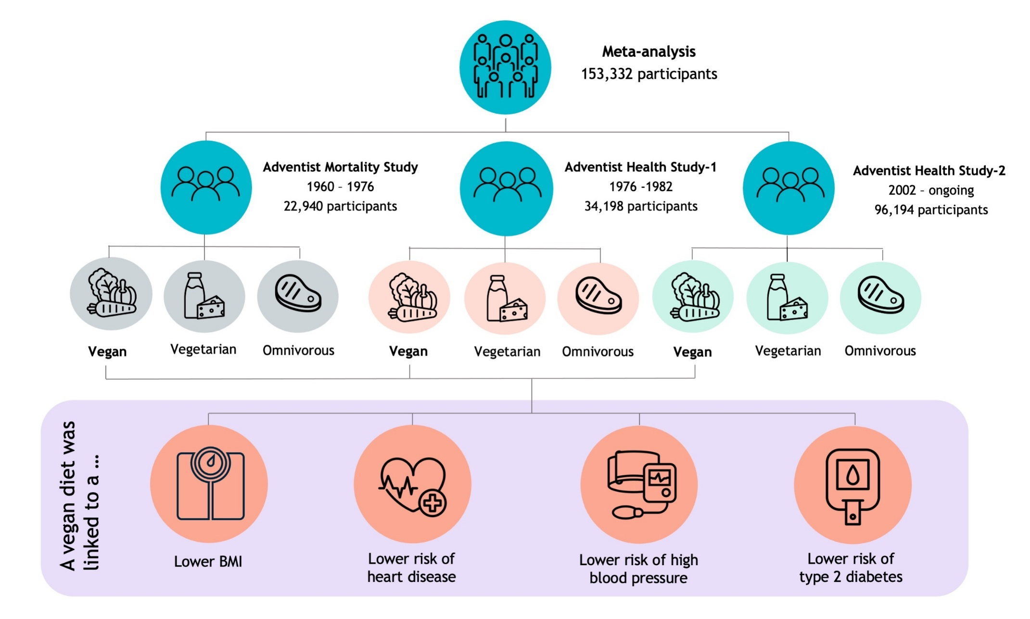
Meta-analysis of population diets

Slide 11
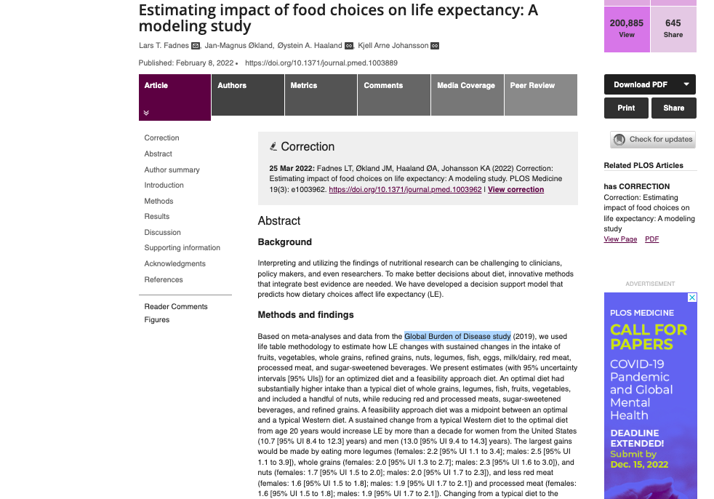

Slide 12
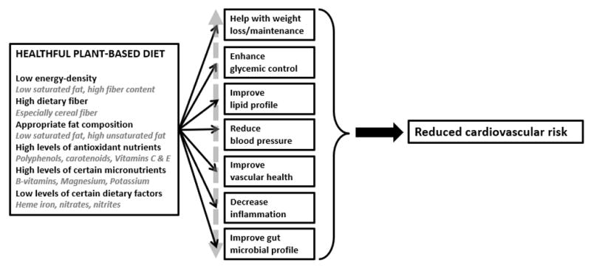
Potential mechanisms underlying CV effects of a plant-based diet, National Library of Medicine

Slide 13
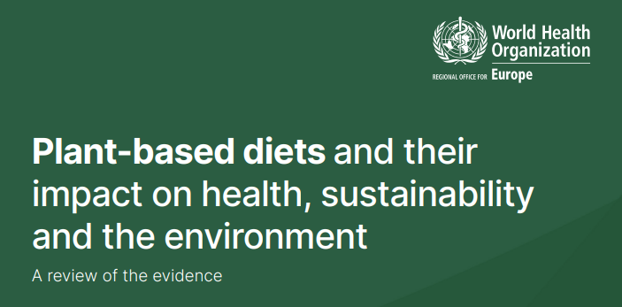
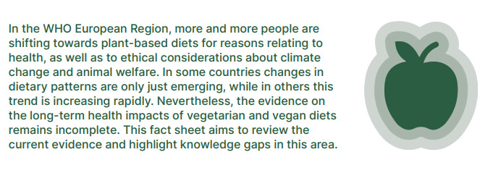

Slide 14
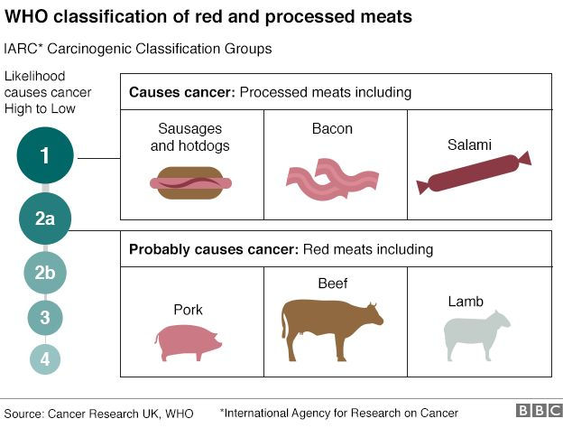

Slide 15
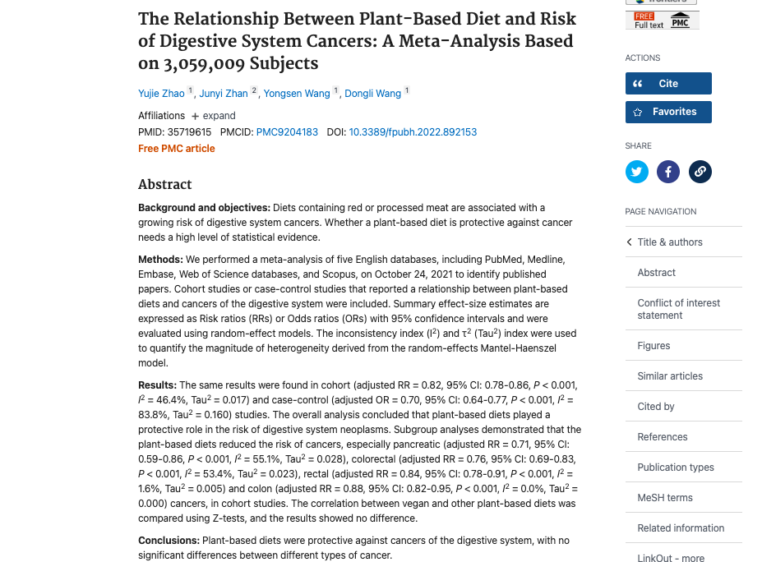
Frontiers In Public Health

Slide 16
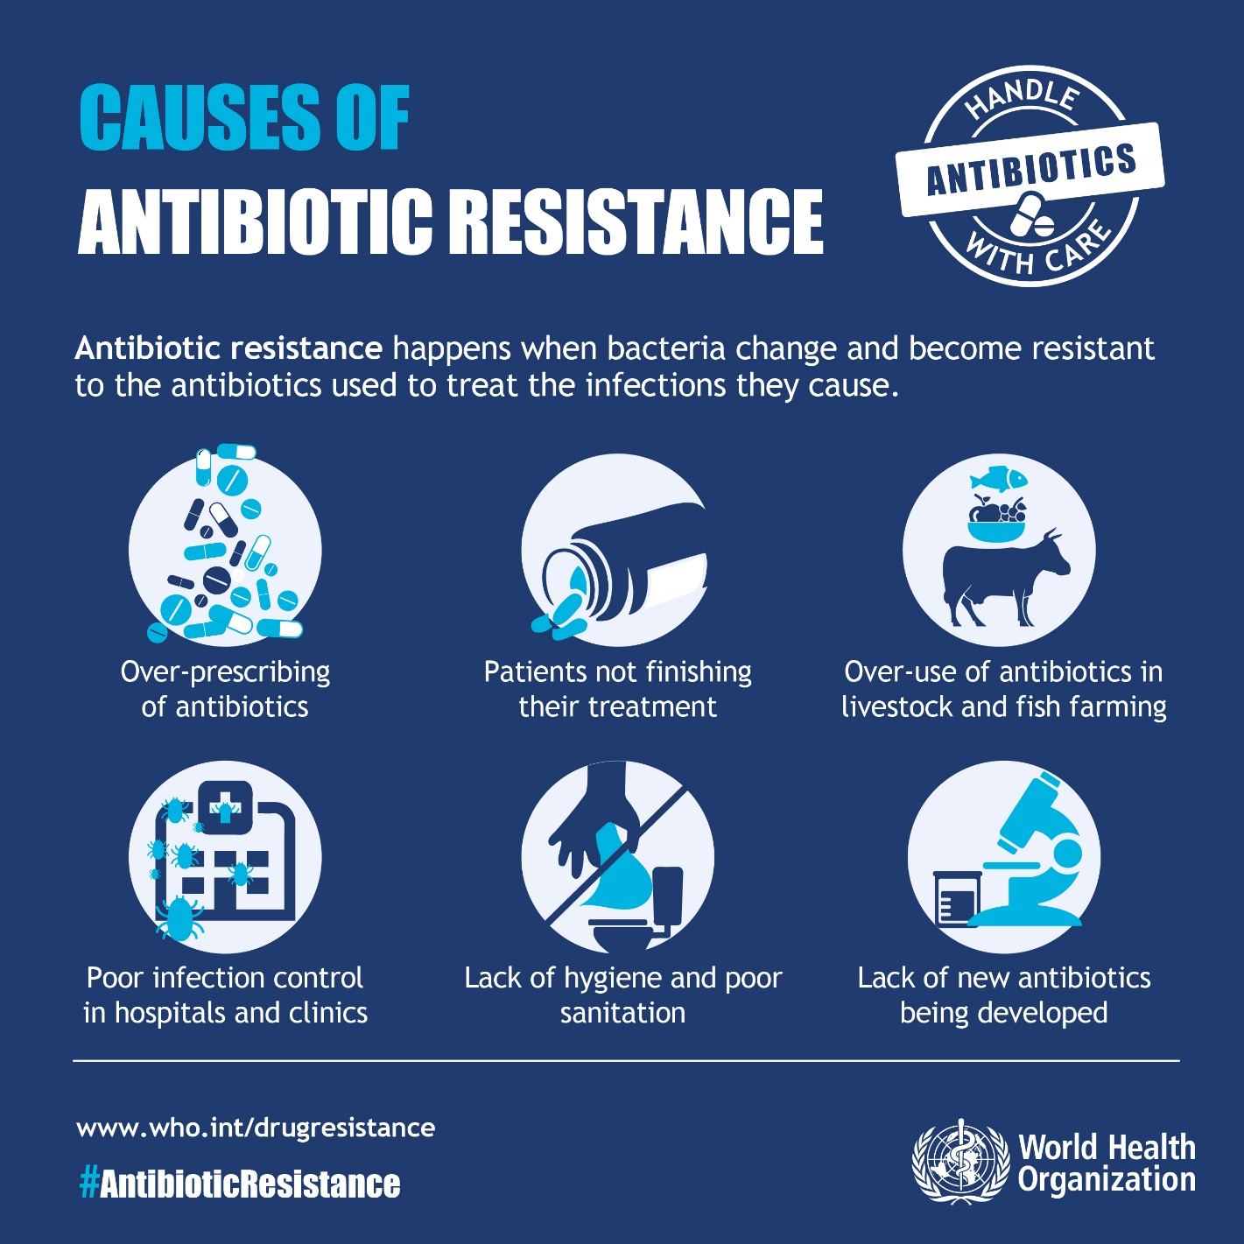

Slide 17
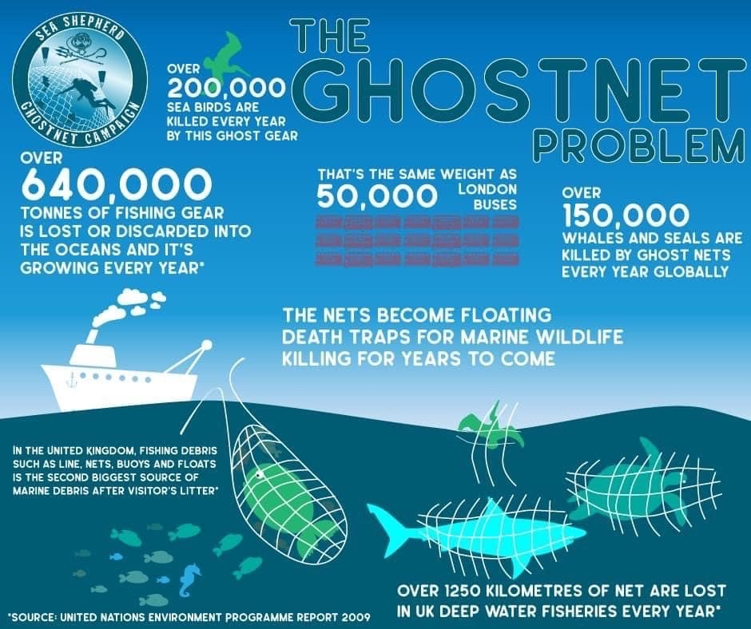

Slide 18
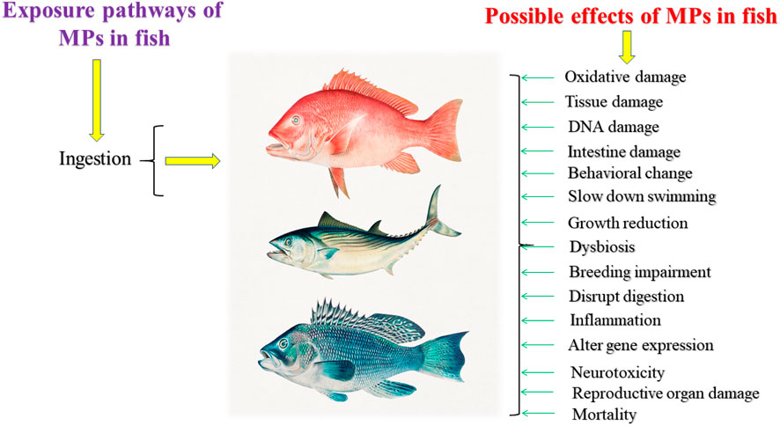
Effects of microplastics on fish and in human health: Frontiers in Environmental Science

Slide 19
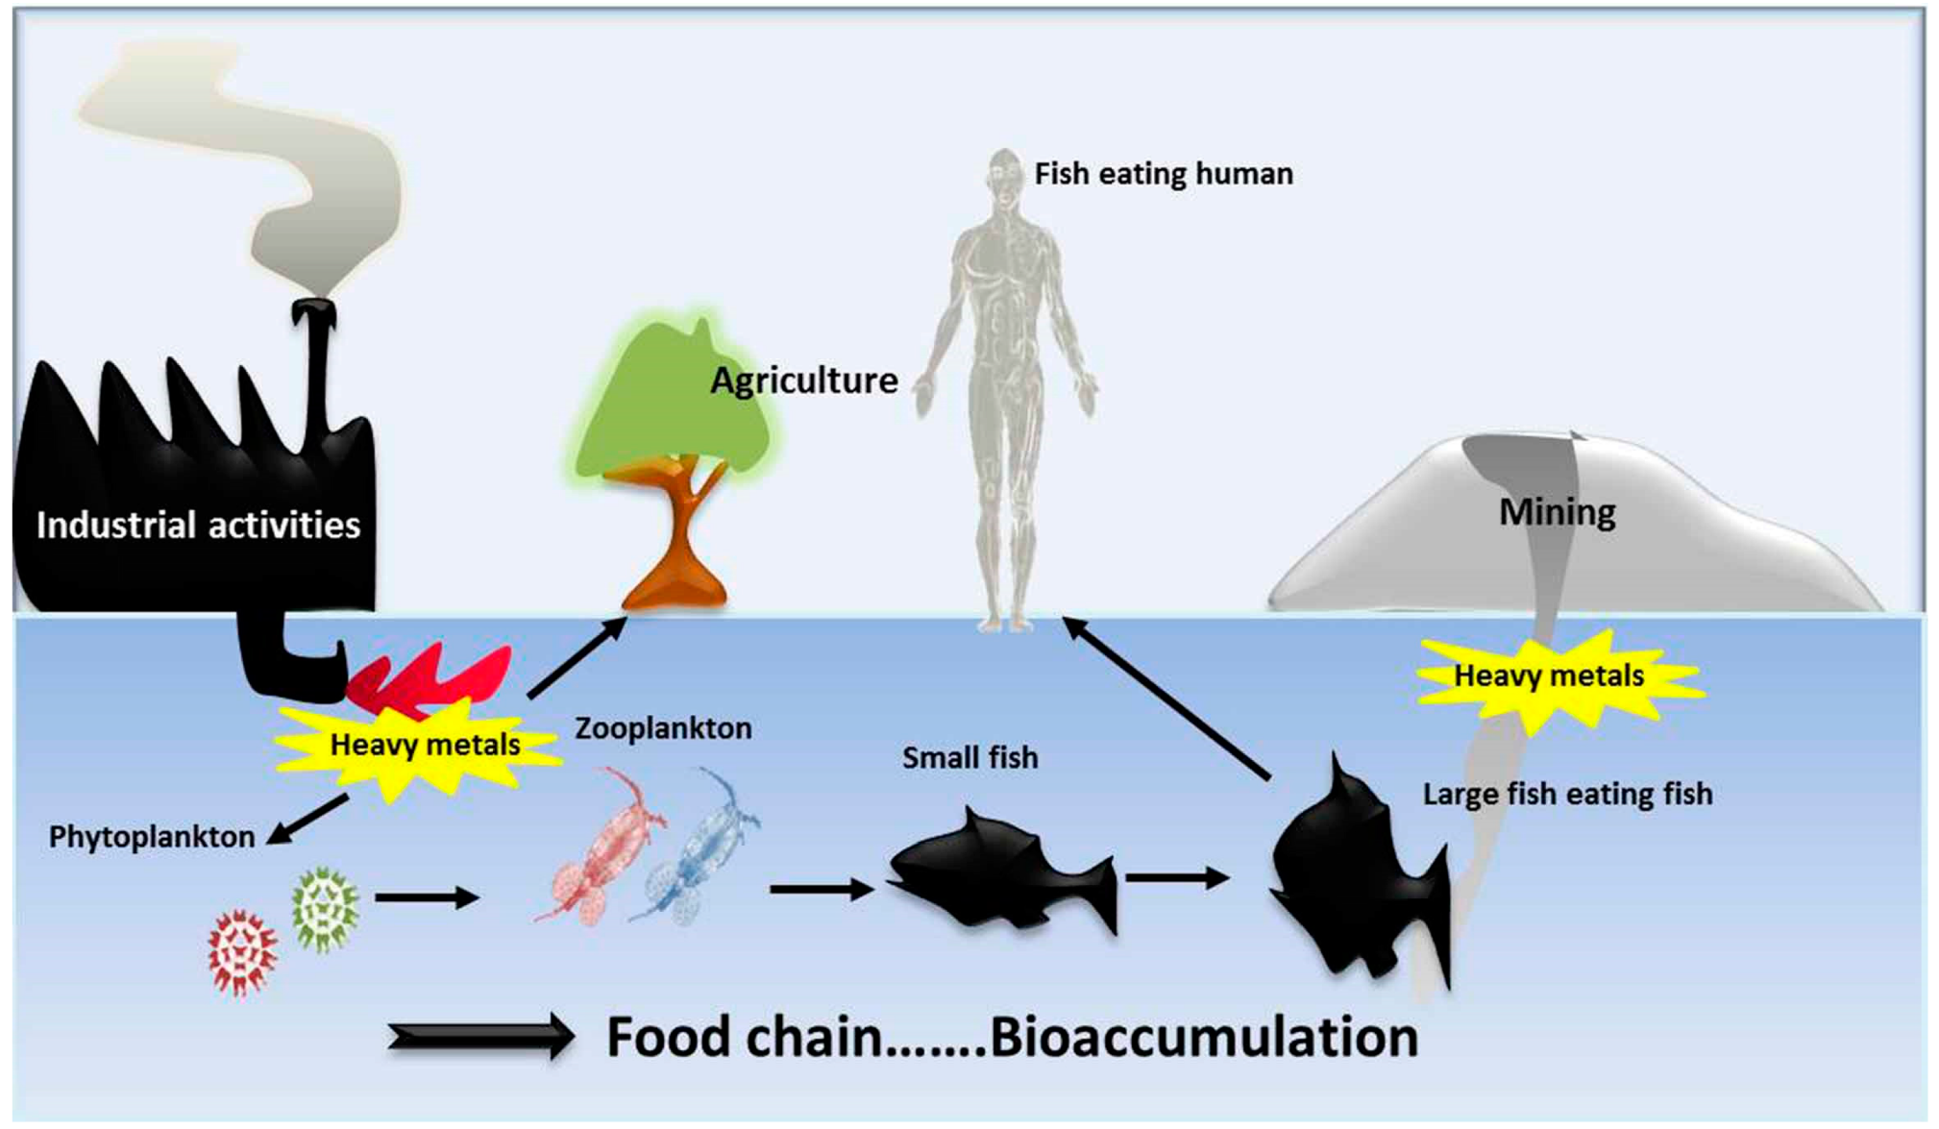
Bioaccumulation in marine life
Biomonitoring of heavy metal pollution in ecosystems: Multidisciplinary Digital Publishing Institute

Slide 20
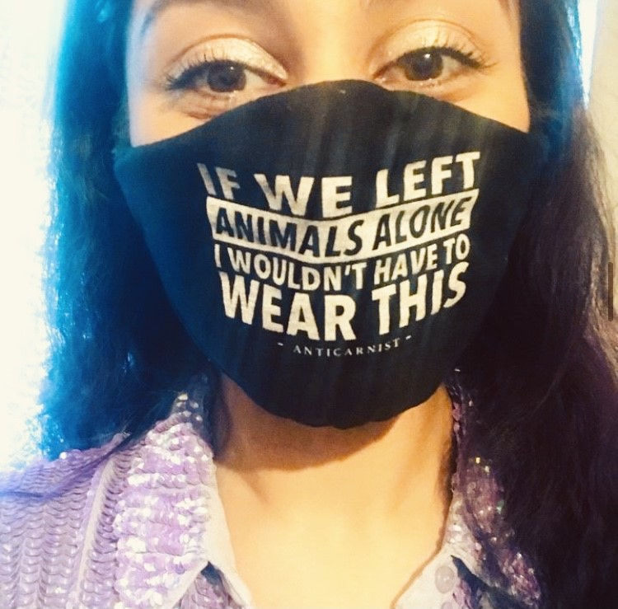
Future pandemics are inevitable
Countless zoonoses such as:
SARS
MERS
BSE
H5N1
H1N1
HIV
COVID19

Slide 21
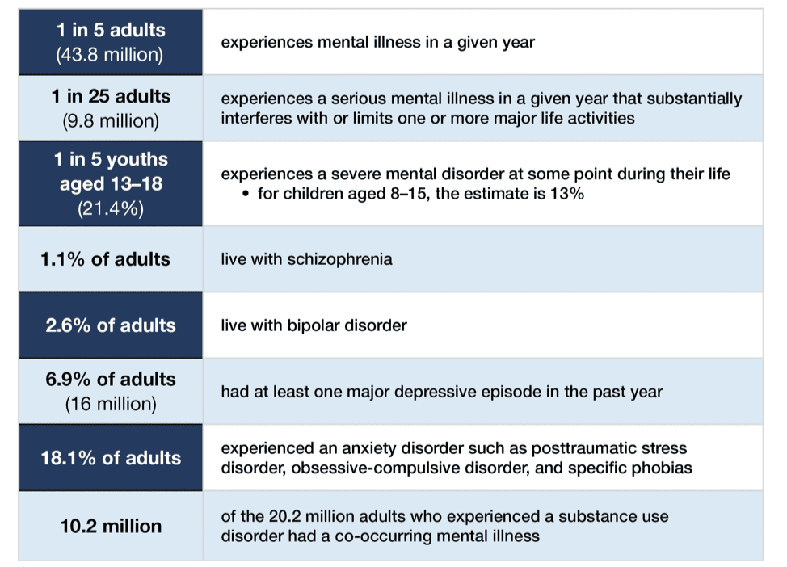
The mental health epidemic
‘State of mental health in America’ report 2019

Slide 22
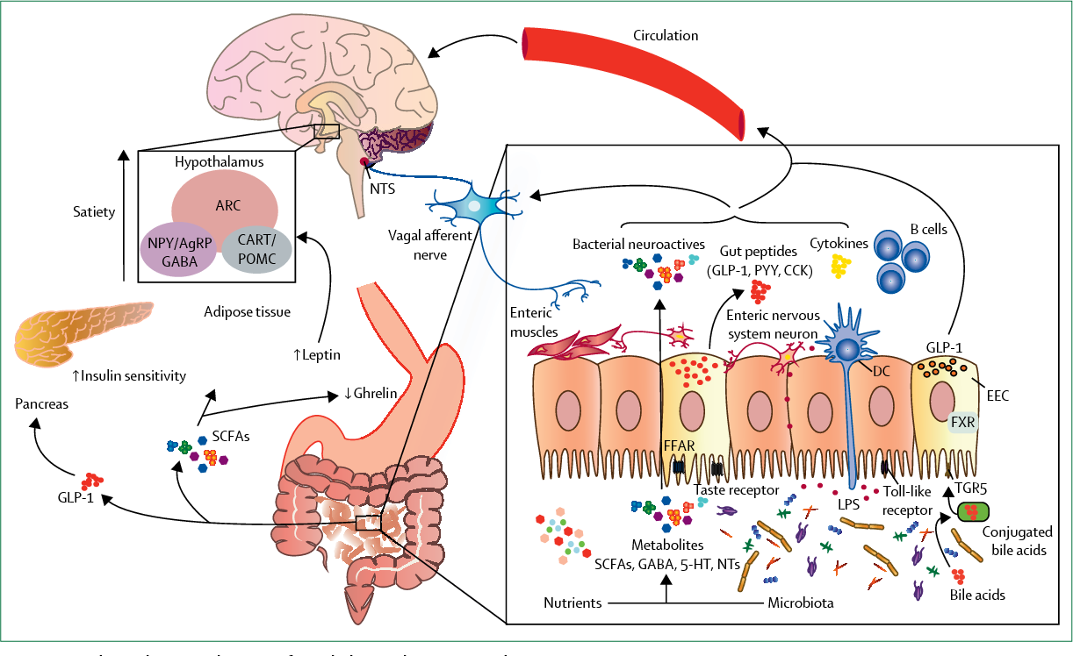
Gut brain axis- food and mood
The microbiota gut brain axis, The Lancet, Gastroenterology

Slide 23
Beetroot- nitrates
Red grapes- resveratrol
Tomatoes- lycopene
Green tea- polyphenols
Seaweed, nori, spirulina
Nuts- omega 3
Fermented foods

Slide 24
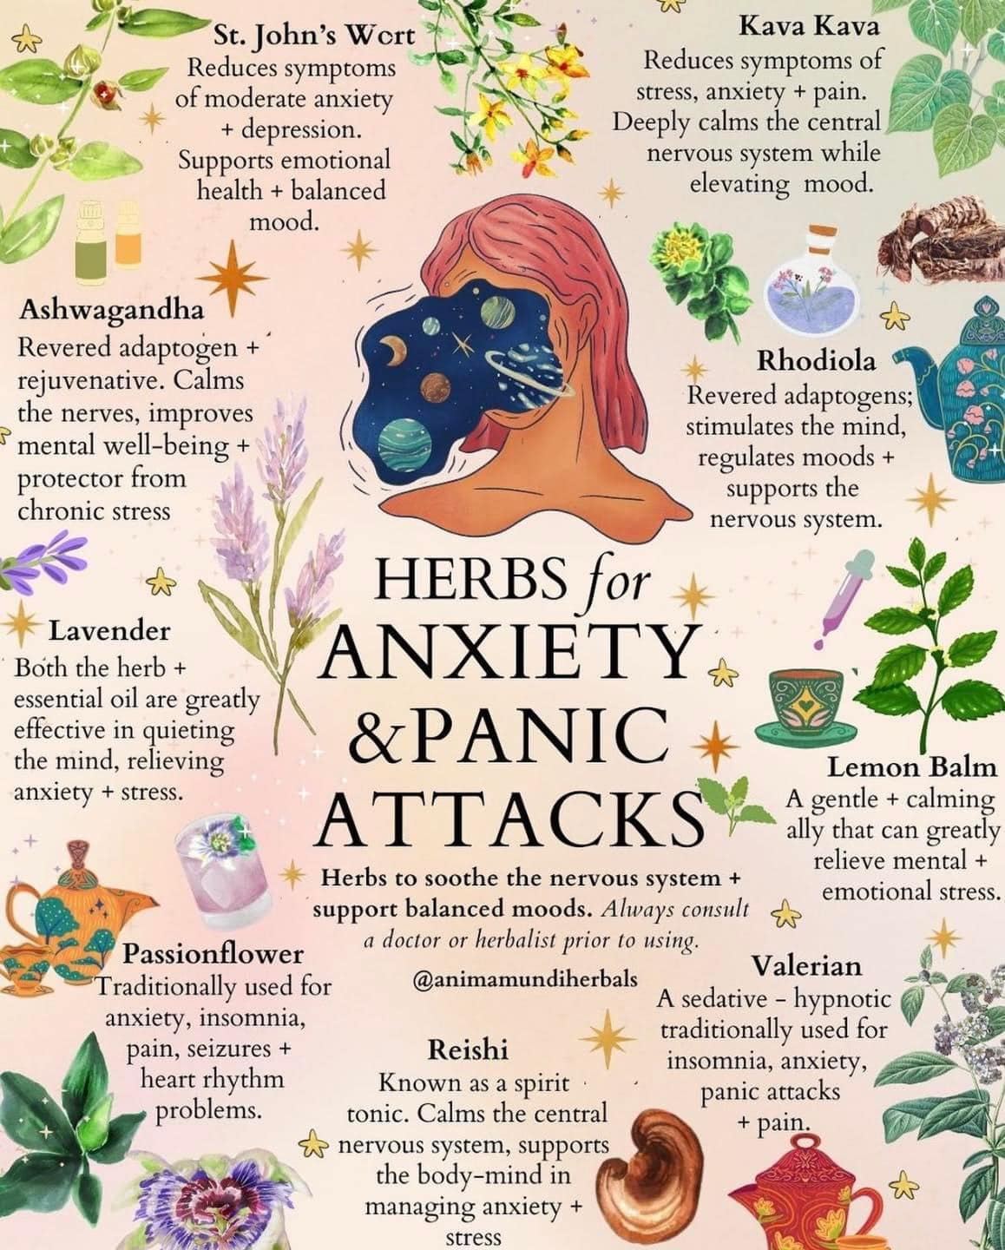

Slide 25
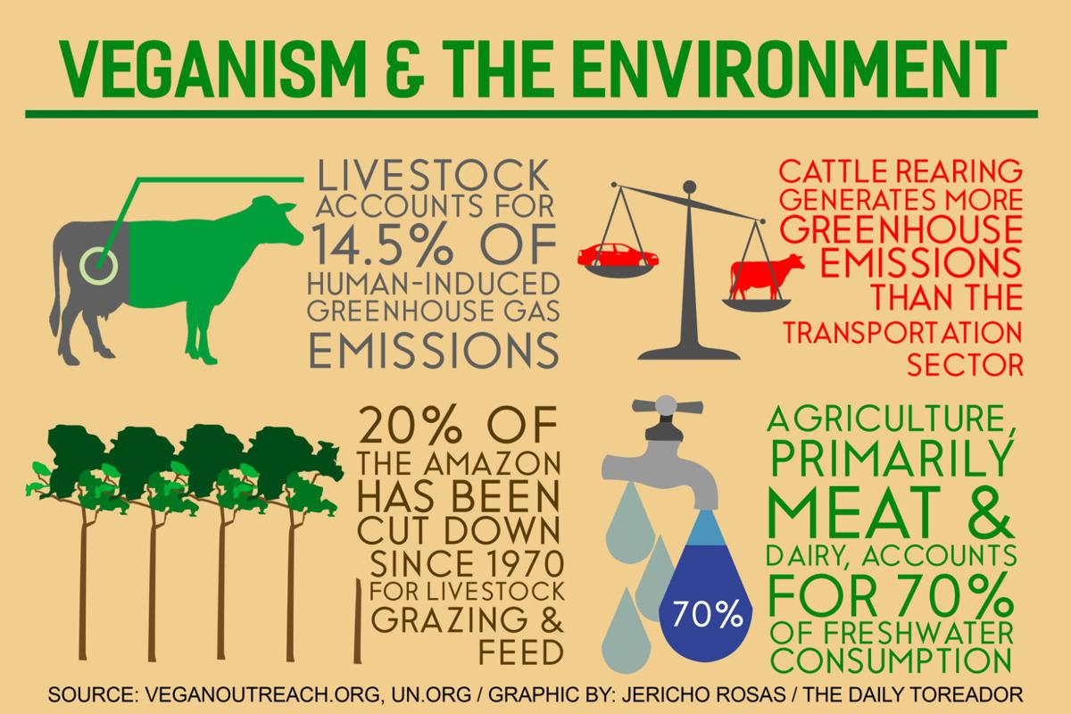

Slide 26
Strong links between individual health and planetary health

Slide 27
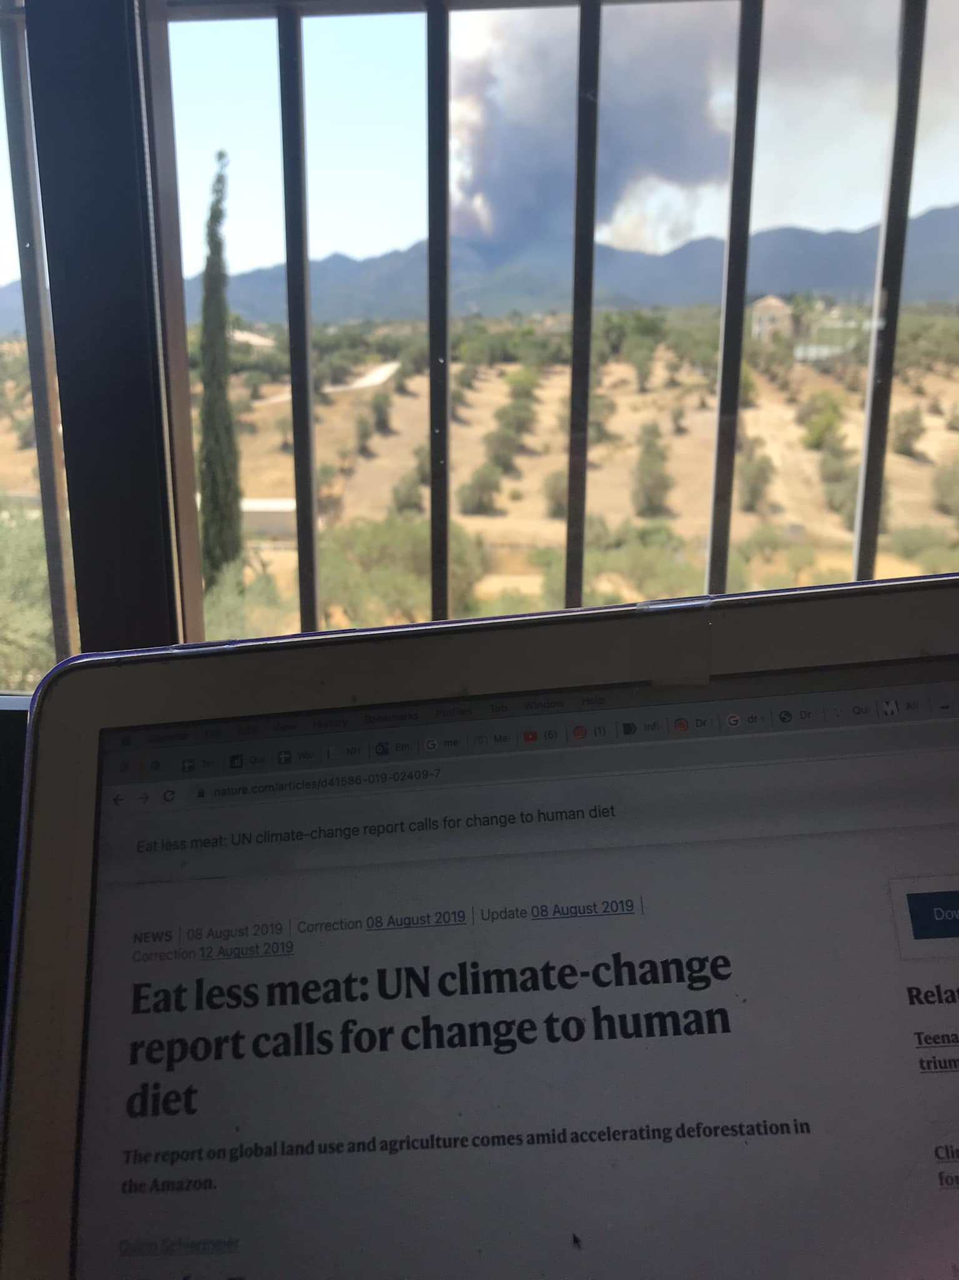

Slide 29
Small, sustainable switches
Veganuary
Meatless Mondays
Wicked, Plant Kitchen, Linda McCartney, Plant Pioneers, Gro, Vivera, Oomph
Oat, hemp, almond, rice, soy, hazelnut, pea, cashew milk

Slide 30
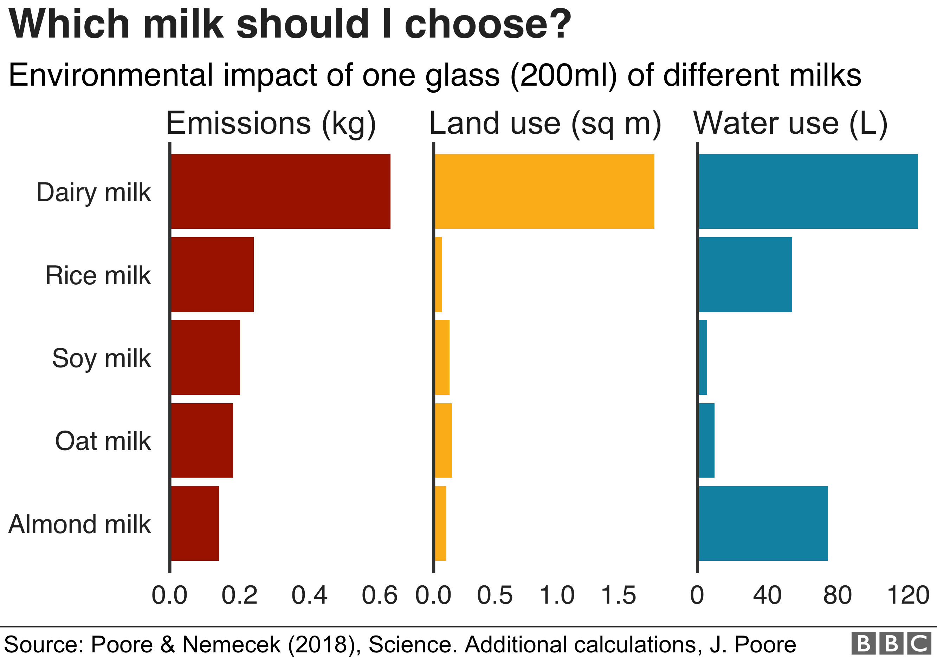
Dairy is scary!

Slide 31
Negative aspects of plant-based diet
Oxford Study of 55,000 people indicates 2.3x increased risk of hip fractures
Nutritional deficiencies such as Fe, B12, zinc demonstrated in some studies
Weekly shop can be more expensive
Variable findings regarding mental health- B12, social isolation, eco-anxiety

Slide 32
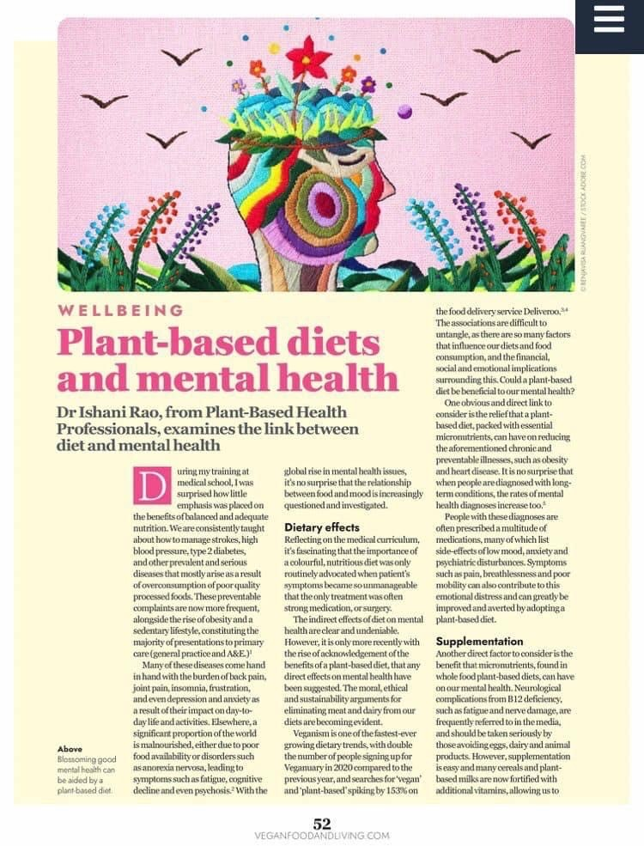
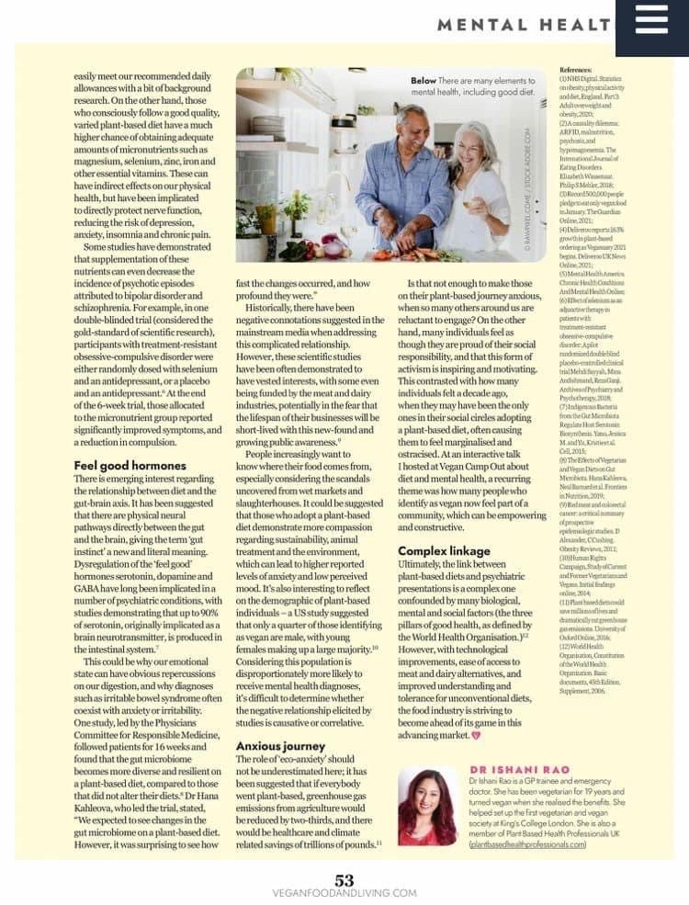

Slide 33
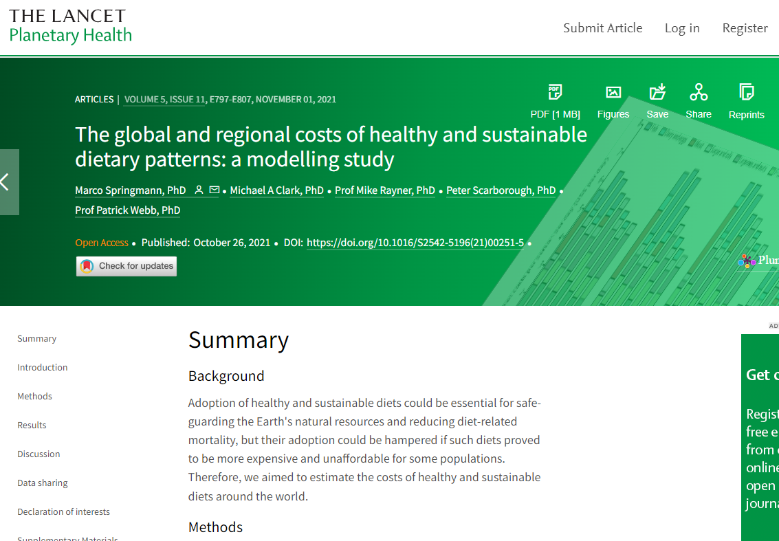
Is a vegan diet more expensive?
Comparable food prices from International Comparison Program for 150 countries
Funded by Global Panel on Agriculture and Food Systems
Up to 1/3 lower cost annually for low, middle, high income countries for plant-based diets

Slide 34
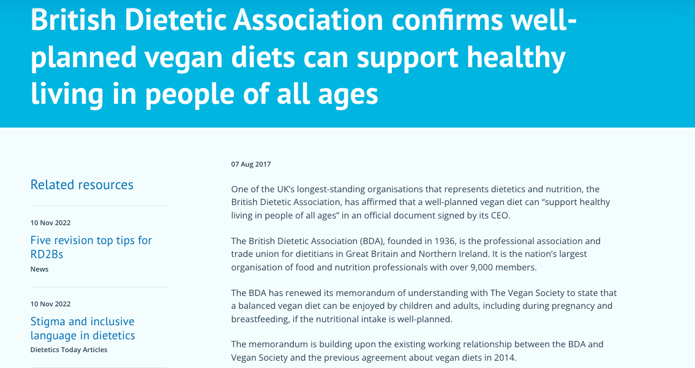
Can we do this in a healthy way?

Slide 35
Useful resources

Slide 36
Recommended organisations
Home - Plant Based Health Professionals UK
Physicians Committee for Responsible Medicine (pcrm.org)
The Vegan Society |
Vegan Health – Evidence-Based Nutrient Recommendations

Slide 37
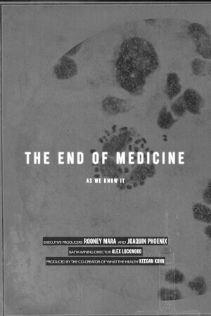
Recommended films

Slide 38
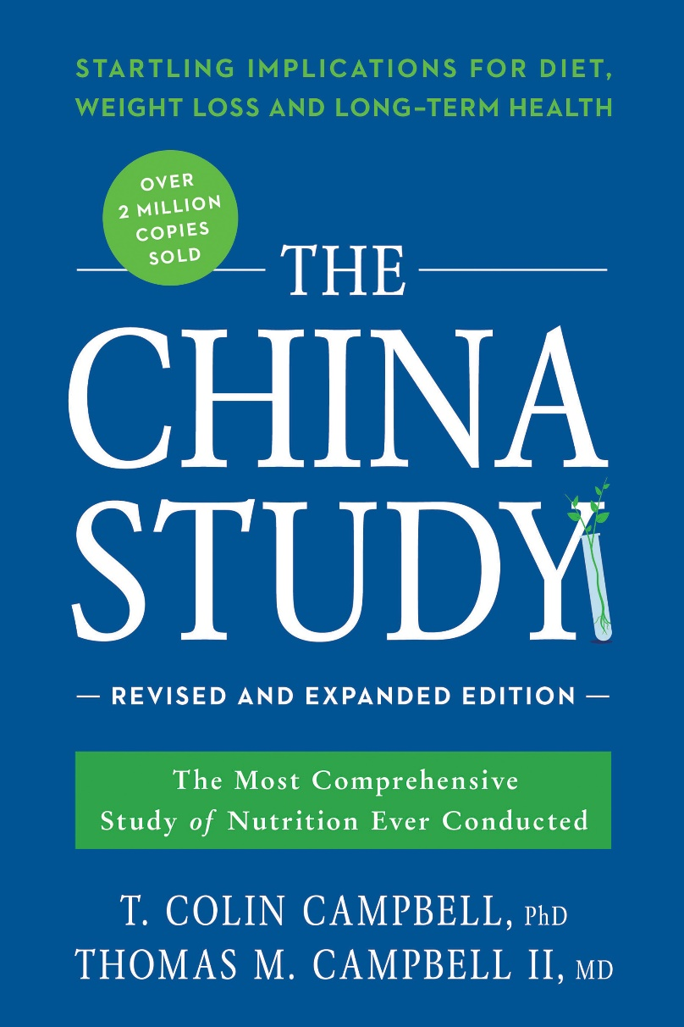
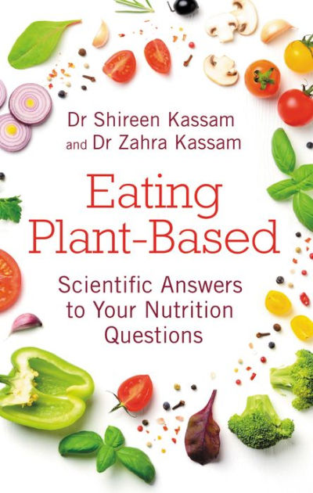
Recommended books

Slide 39
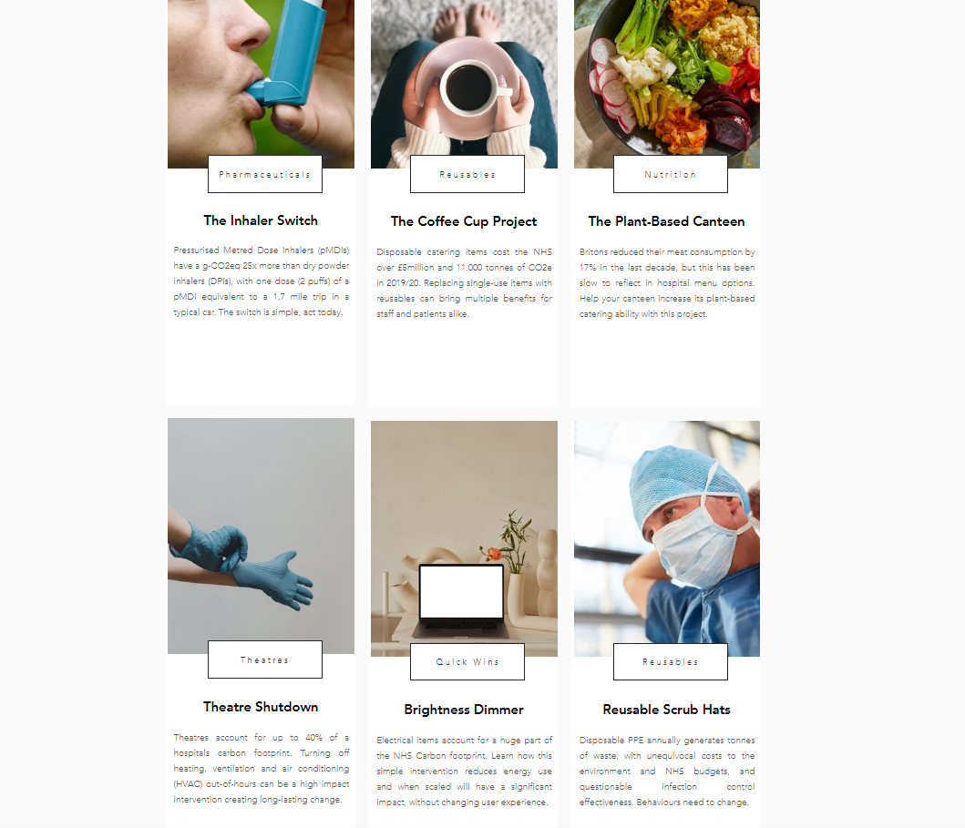
EcoMedics QIP bank

Slide 40
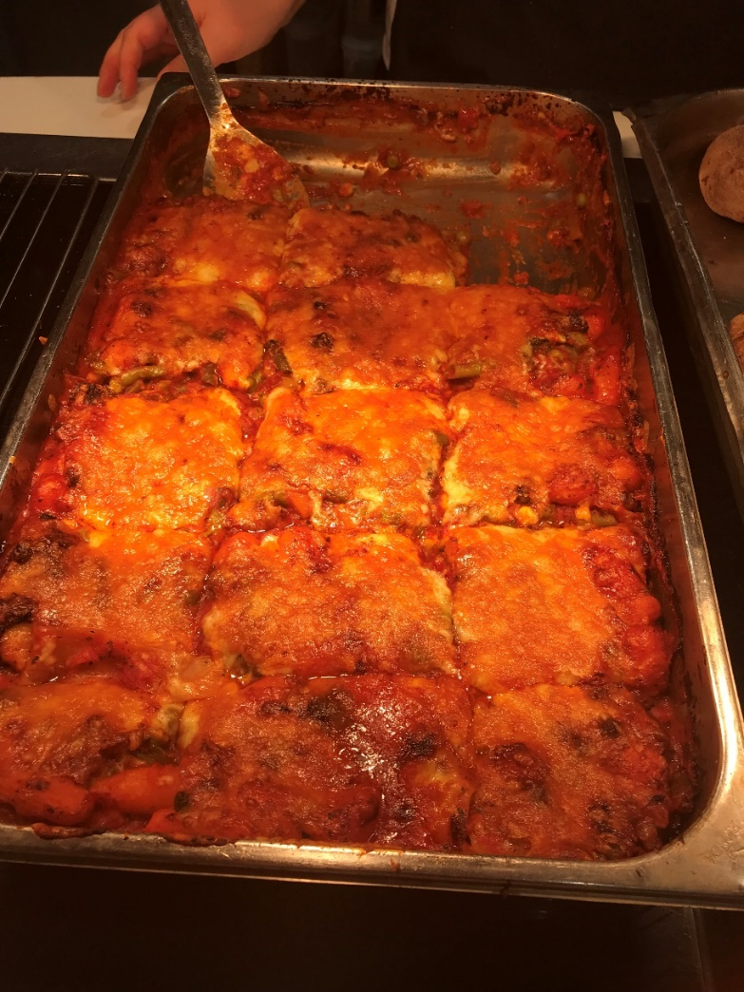
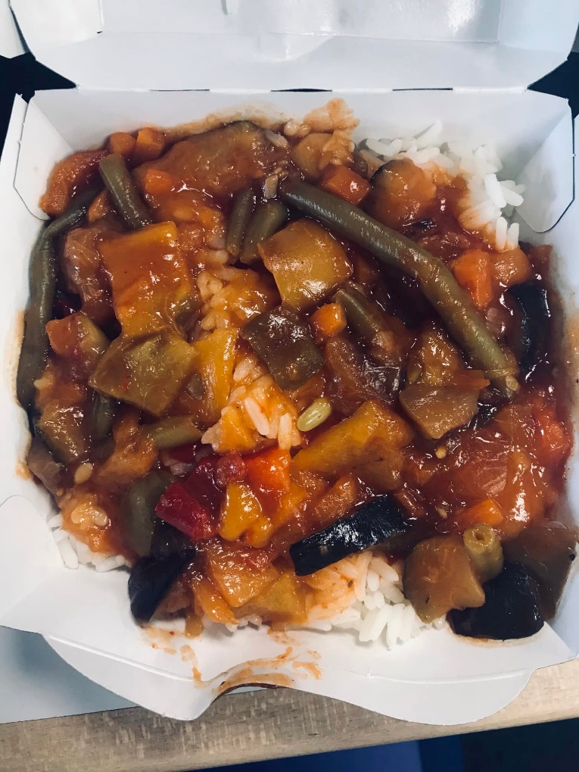
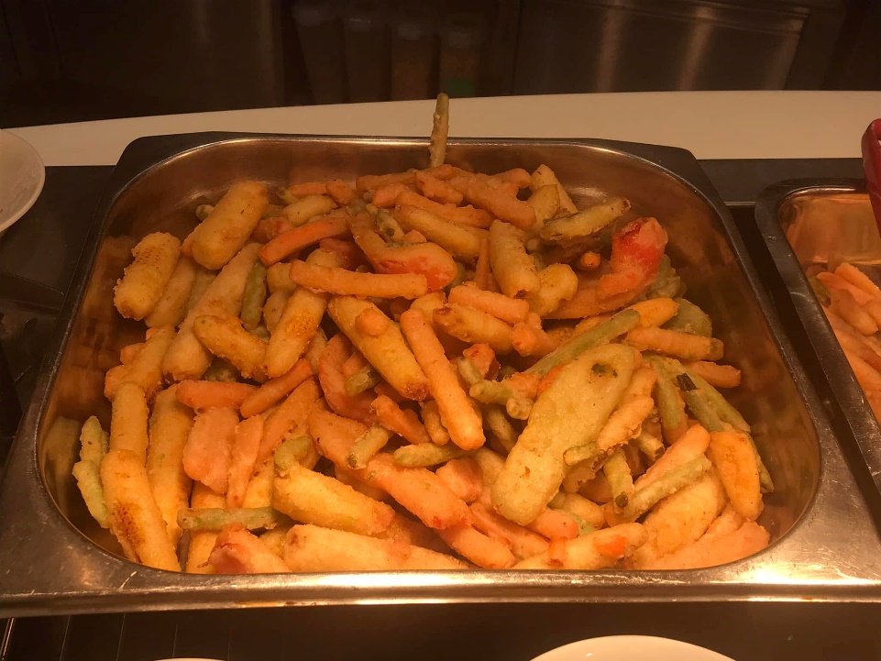
After a year of advocating at MTW…

Slide 41
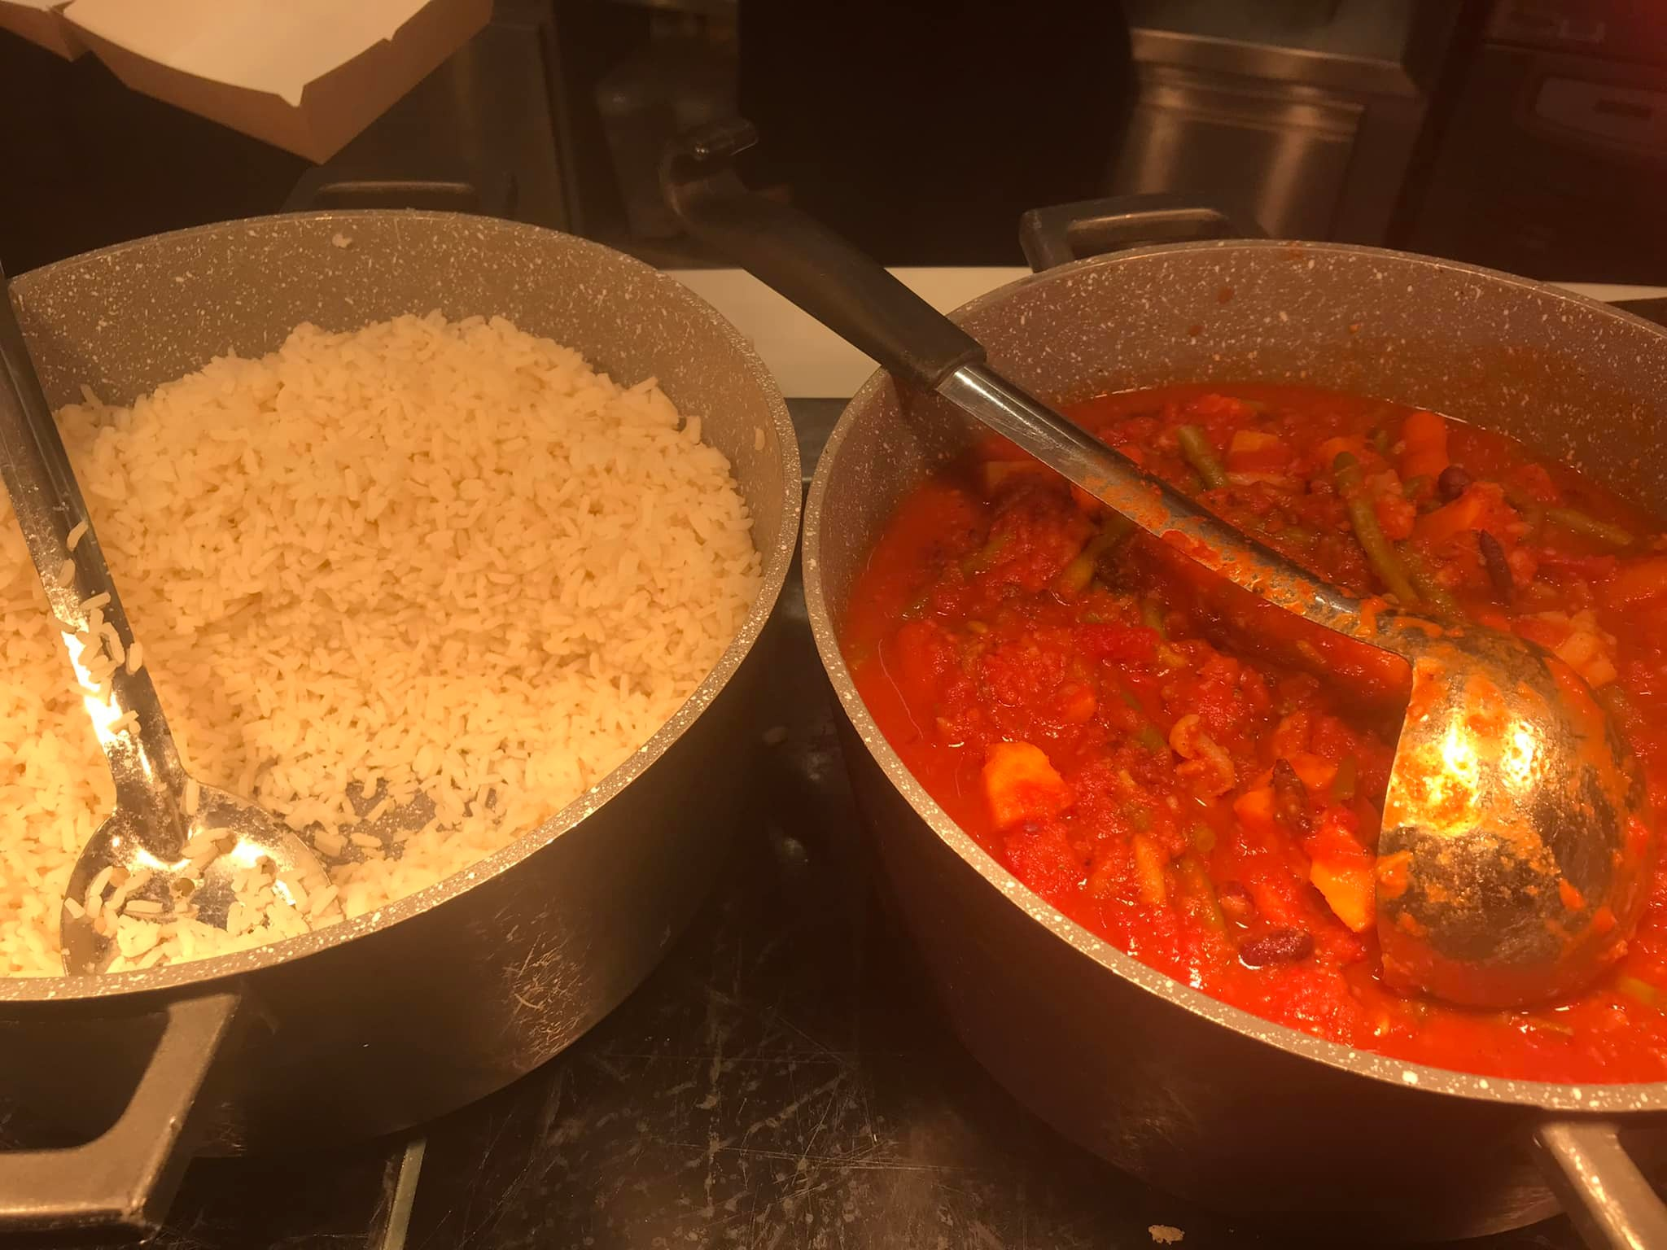

Slide 42
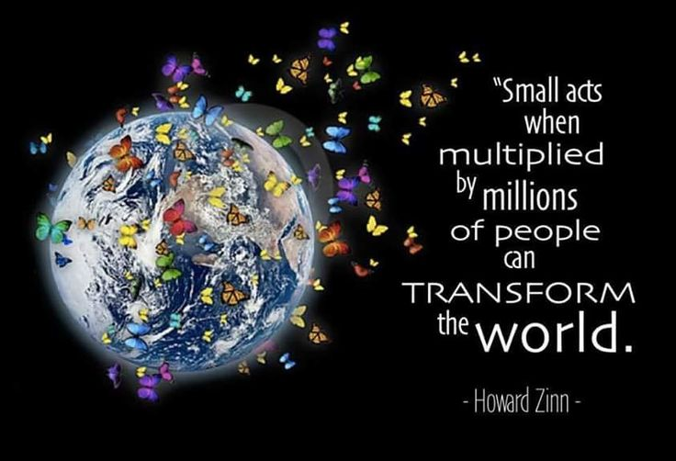

Slide 43
Thank you for listening
i.rao@nhs.net
Linkedin- Dr Ishani Rao
www.bucketsoflove.co.uk

