Slide 1
Making the Most of Fertility Hormones (The most frequent Duty Biochemist queries)
Hosted By Clinical Biochemistry
Maidstone & Tunbridge Wells NHS Trust
19th October 2022

Slide 2
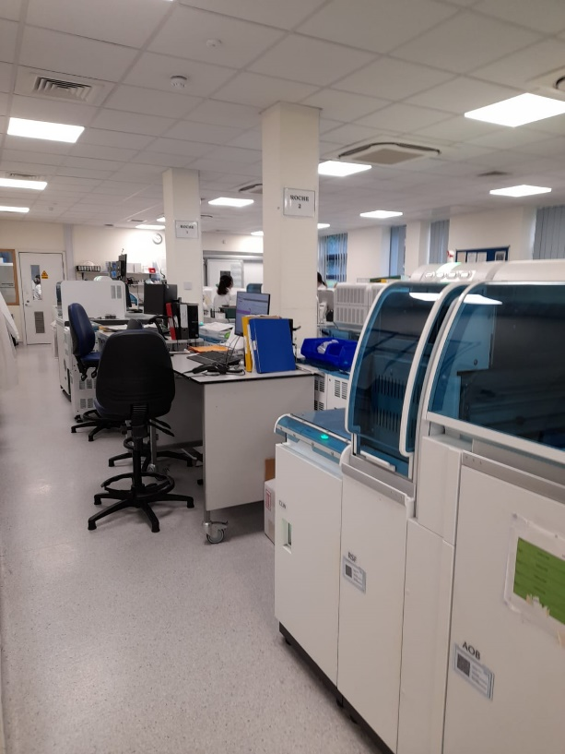
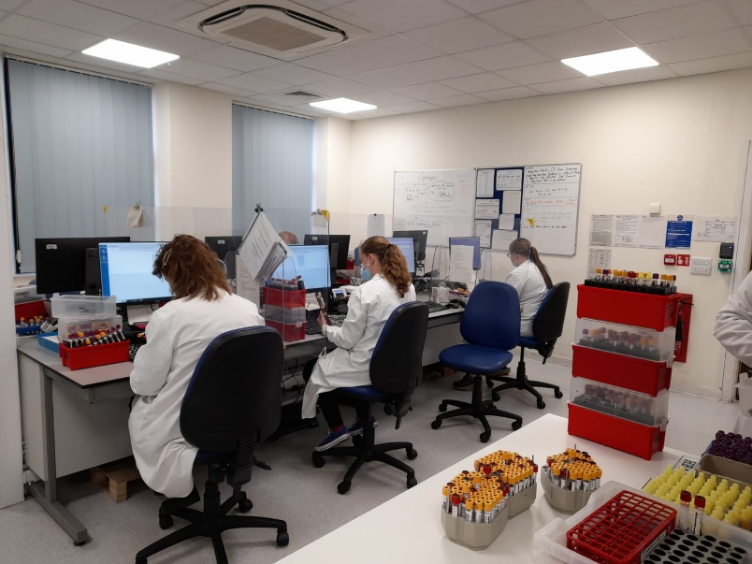
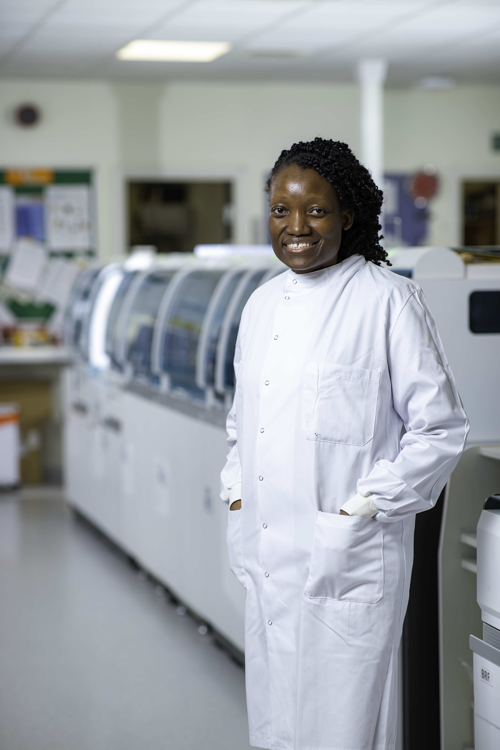
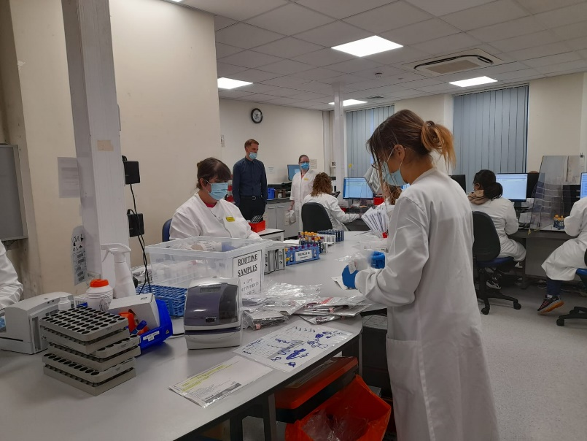
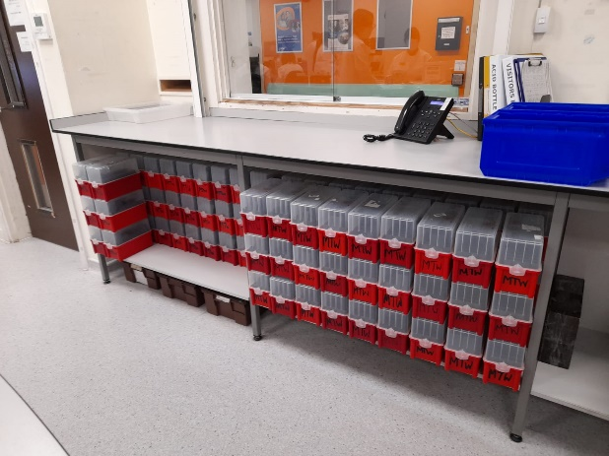
Maidstone Laboratory

Slide 3
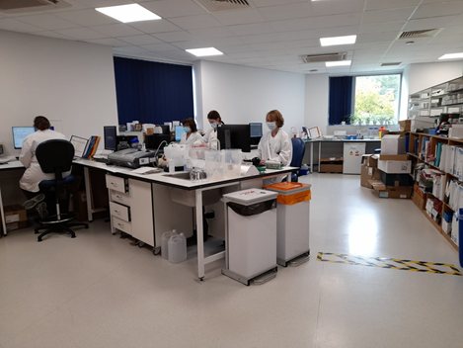
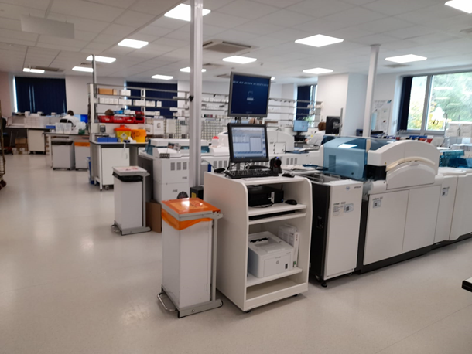
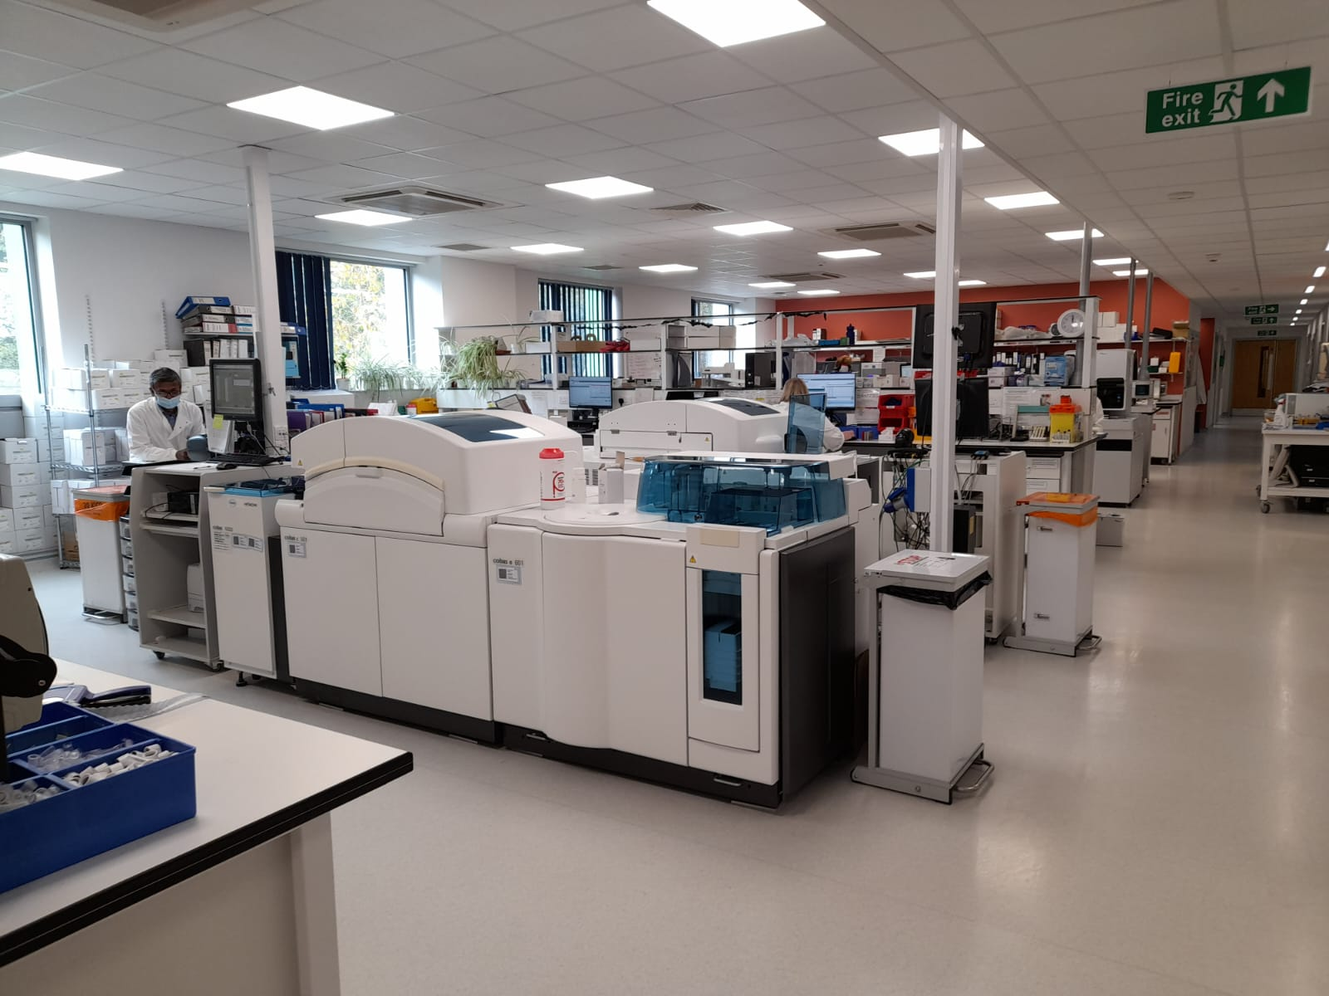
Pembury Laboratory

Slide 4
Overview of Session
What can Clinical Biochemistry do to add clinical value and support interpretation of results?
Aim of this session is to provide quick straightforward answers that can help you in your clinical practice
Focus on Fertility Hormones
Testosterone
Free Androgen Index
Oestradiol
SHBG
LH & FSH
In Clinical Context Of
Hypogonadism
Amenorrhoea
Ovarian
Failure
PCOS
Menopause

Slide 5
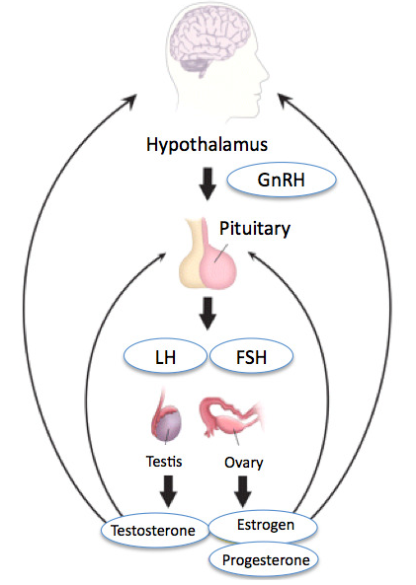
Fertility Hormones

Slide 6
SHBG Bound
Testosterone
(≈45%)
Free
Testosterone
(≈2%)
Total Testosterone
(This is what we measure)
Bioavailable Testosterone
Albumin Bound
Testosterone
(≈50%)

Slide 7
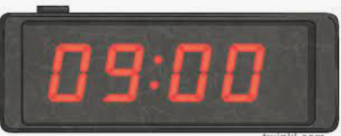
Total Testosterone In Adult Males
(08:00 to 10:00 is a morning sample)
What is a low value?
<8 nmol/L low
8 to 10 nmol/L borderline
What is the clinical context?
Is the lower limit of reference range too high?
Factors Affecting Testosterone
Diurnal variation – 25% lower by 4pm
Age
Acute illness
BMI
Exercise
Fasting
Age 20 to 49 years Lower Limit is 11.4 nmol/L
Age >50 years Lower Limit is 9.5 nmol/L

Slide 8
Fertility Hormones

Slide 9
Interpreting Testosterone With LH & FSH
Typical patterns seen in males
Testosterone
LH & FSH
Testosterone
LH & FSH
Primary Testicular Failure
Hypogonadotrophic Hypogonadism
Testosterone
LH
FSH
Testosterone
LH & FSH
FSH
Primary Testicular Failure
Hypogonadotrophic Hypogonadism

Slide 10
Hypogonadotrophic Hypogonadism
(…suggest repeat and if testosterone remains low refer to Endocrinology)
We see a lot of hypog hypog patterns in males – are they all pituitary?
How many cases is the low testosterone a result of BMI and other life style factors leading to a functional hypothalamic cause rather than pituitary?
Would a change in lower limit of testosterone reference range reduce the number of Endocrinology referrals?
Organic causes of hypogonadism must be excluded.
When a low testosterone with low or inappropriately normal gonadotrophins is found, we reflex:
TSH and FT4
Prolactin
In pituitary pathologies, the hypothalamic-pituitary-gonadal axis is the first to be disrupted – do not want to miss hypopituitarism.
Depending on the clinical context, signs and symptoms a 9am cortisol may be indicated.

Slide 11
A Word on Free Testosterone…
…Not offered at MTW as either measured or calculated
Free Testosterone Assays
Chemistry methods developed to measure free testosterone are not widely available and onerous.
Method agreement varies considerably even between mass spectrometry (gold standard).
Free Testosterone Calculations
Various calculations exist that use total testosterone, albumin and SHBG.
Most utilised is the Vermeulen method but, this overestimates the true value.
Clinical Evidence
The evidence base supports total testosterone as a better indicator of hypogonadism.
Proceed with caution!
Clinical relevance of free testosterone is controversial.
Many best practice guidelines endorse the use of free testosterone calculations despite the evidence base demonstrating its unreliability and overestimation of true values.

Slide 12
High Testosterones In Males
Upper limit of reference range for 20 to 49 years of age is 27.9 nmol/L
Upper limit of reference range for >50 years of age is 28.3 nmol/L
Upper reporting limit of the assay is >52 nmol/L
Causes of high testosterone in males
Testosterone replacement
Taking body building steroids
Assay interference
Androgen-producing testicular tumour
Androgen-producing adrenal tumour
Increased risk of polycythaemia - FBC should be performed to check for raised Hb and MCV

Slide 13
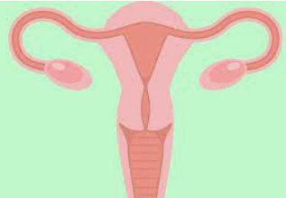
Testosterone In Females
Adrenal Glands
Ovaries
Androstenedione/DHEA
Testosterone
Causes of raised testosterone in females
Polycystic Ovary Syndrome (PCOS)
Familial/idiopathic hirsutism
Drugs e.g. phenytoin
Pregnancy
Assay interference
Cushing’s syndrome
Androgen-producing adrenal tumour
Androgen-producing ovarian tumour
Late onset congenital hyperplasia
Abnormalities of gonadal or sexual development

Slide 14
What is a High Female Testosterone?
Upper limit of reference range for 20 to 49 years of age is 1.7 nmol/L
Upper limit of reference range for >50 years of age is 1.4 nmol/L
(Don’t worry about <0.2 nmol/L – it’s not clinically significant)
All high testosterones (>3 nmol/L) are sent for confirmation by mass spectrometry because immunoassay is subject to other androgen interference
* Measurement of testosterone in females on testosterone therapy is not recommended
>1.8 to 5 nmol/L
5 nmol/L to >10 nmol/L
PCOS
Idiopathic hirsutism
Pregnancy
Assay Interference
Assay Interference
Testosterone therapy (HRT)*
Transgender patients
Pregnancy
Adrenal/ovarian tumours

Slide 15
Case – Female High Testosterone
Young female
Total testosterone = 7.9 nmol/L
Elevated testosterone confirmed by Mass Spectrometry as 7.2 nmol/L
On further discussion with patient her partner was currently using testogel

Slide 16
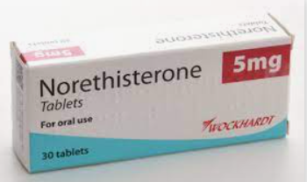
Case – Female High Testosterone
38 year old female
Irregular periods and trying to conceive
Tests | Results
Total Testosterone (nmol/L) | 7.5
FAI (%) | 20.8
SHBG (nmol/L) | 36.0
Progesterone (nmol/L) | <1.0
FSH (mIU/L) | <2.0
Testosterone was confirmed by Mass Spectrometry
0.3 nmol/L

Slide 17
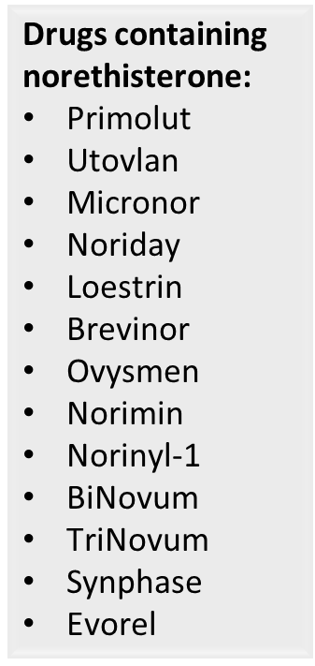
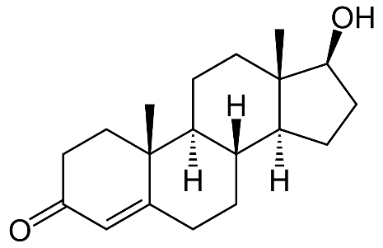
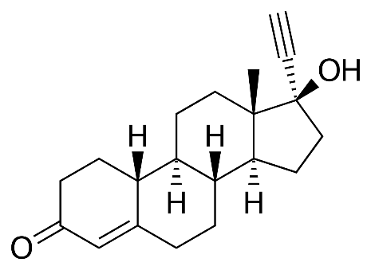
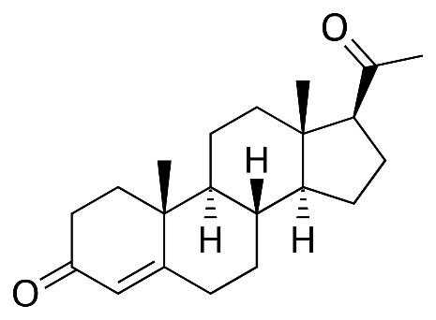
Norethisterone Assay Interference
Testosterone
Norethisterone
Progesterone

Slide 18
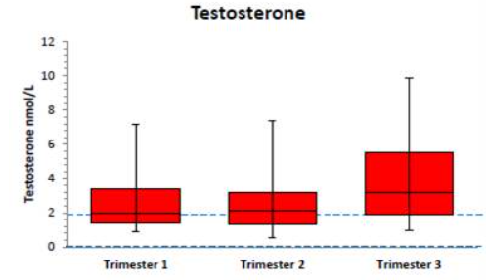
Testosterone in Pregnancy
Case
Pregnant with PCOS
1st Trimester
Total Testosterone = 9.6 nmol/L
Mass Spectrometry = 8.5 nmol/L
Data provided by referral laboratory

Slide 19
How to interpret female testosterone concentrations in patients under the age of 20
(Currently there are no MTW reference intervals for this age group)
Are they menstruating?
Have they gone through puberty?
What Tanner Stage are they at?
What is the clinical question?

Slide 20
Sex Hormone Binding Globulin (nmol/L)
SHBG synthesised by the liver and binds to testosterone, oestradiol and other steroids
Transports testosterone in the blood in its inactive form
Clinical use investigating
hirsutism in women
reduced libido/ED in men IF the testosterone is normal and it does not fit the clinical picture
High SHBG
More inactive hormone binds
Less bioavailable hormone is available for metabolic actions
Low SHBG
Less inactive hormone binds
More bioavailable hormone is available for metabolic actions

Slide 21
Androgen Deficiency
Growth Hormone Deficiency
AEDs
Pregnancy
Hyperthyroidism
OCPs
Raised Prolactin
PCOS
Elevated SHBG
Liver Cirrhosis
Elderly Men
Acromegaly
Low
SHBG
Anorexia
Familial
Glucocorticoids
Insulin Resistance
Obesity
Hypothyroidism

Slide 22
Free Androgen Index (FAI)
Free Androgen Index (FAI) % = Total Testosterone x 100
SHBG
FAI is a tool to assist in the investigation of hyperandrogenism in females
It provides an indication of bioavailable testosterone
FAI is not appropriate in males (lower SHBG and higher testosterone in males makes the calculation unsuitable)
Changes in albumin concentration affect FAI

Slide 23
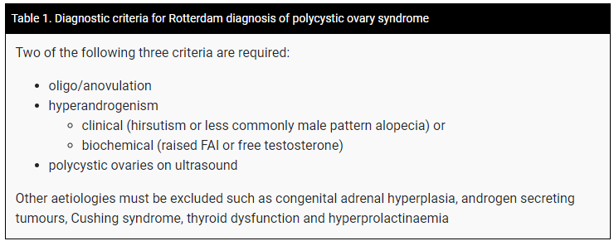
Polycystic Ovary Syndrome (PCOS)
Clinical & biochemical diagnosis ….but probably more clinical
Rotterdam Criteria
Normal to moderately elevated total testosterone
Normal to low SHBG
Normal or elevated FAI (normal range <5%)
Exclude other causes of oligo or amenorrhoea

Slide 24
PCOS in Adolescents
Ultrasound is not recommended in adolescents
Signs and symptoms of hyperandrogenism e.g. acne, hirsutism AND
Irregular menstrual periods
In adolescent girls (12 to 17 years), both hyperandrogenism and irregular menstrual cycles are required for a diagnosis of PCOS
Adolescents who have features of PCOS but do not meet the diagnostic criteria should be considered as increased risk AND
Reassessed at or before full reproductive maturity – 8 years post-menarche

Slide 25
Assessing PCOS Biochemically
Looking for evidence of hyperandrogenism
Samples for testosterone and SHBG (FAI will automatically be calculated) collected on day 1 to 5 (during menses) of the menstrual cycle.
Measure the following to rule out other causes of oligomenorrhoea and amenorrhoea
FSH and LH
(to exclude premature ovarian failure/hypogonadotrophic hypogonadism)
Prolactin
(to exclude hyperprolactinaemia)
TSH
(to exclude hypothyroidism)
LH to FSH ratio is not recommended as there is no is evidence base.
LH to FSH ratio is non-specific

Slide 26
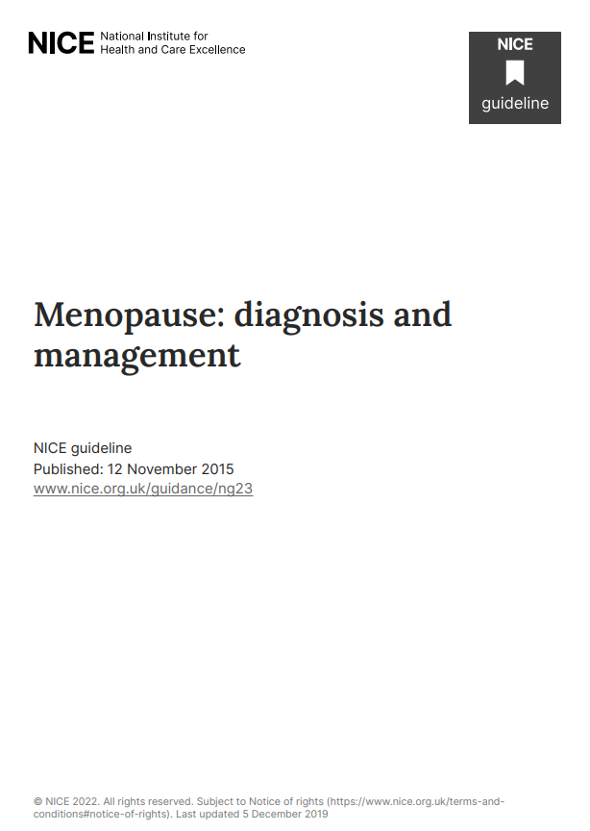
Role of FSH in Female Patients
Clinical utility in diagnosing menopause and assessing need for contraception
Nice Guidelines NG23
Do not use FSH in otherwise healthy women aged over 45 years with menopausal symptoms
Consider using FSH to diagnose menopause only:
In women aged 40 to 45 years with menopausal symptoms, including a change in their menstrual cycle
In women aged 40 years in whom menopause is suspected
FSH measurement & contraception
Cannot use in women on combined oral contraceptives
Can use in women on progesterone only (POP) if >50 years
X
√
LH is not indicated or clinical useful in: Diagnosing menopause
Deciding to cease contraception
X
X

Slide 27
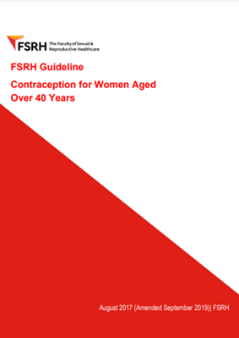
FSH in Contraception

Slide 28
Suppressed Gonadotrophins in Females
Pill, Pregnancy, Prolactinoma or Pituitary!
LH <1.0 IU/L and FSH <2.0 IU/L
Stress
Exercise
Low BMI
Pregnancy
OCPs/HRT
OR
Hypogonadotrophic hypogonadism
Prolactinoma
32 year old female
LH <1.0 IU/L
FSH <2.0 IU/L
Prolactin = 1256 mIU/L
Testosterone = 2.1 nmol/L
Pregnant
26 year old female
LH <1.0 IU/L
FSH <2.0 IU/L
Prolactin = 370 mIU/L
TSH = 3.8 mIU/L
FT4 = 15.1 pmol/L
On Combined OCP
58 year old female
LH <1.0 IU/L
FSH <2.0 IU/L
TSH = 2.7 mIU/L
FT4 = 10.4 pmol/L
Prolactin = 2560 mIU/L
Prolactinoma
Is the patient amenorrhoeic?

Slide 29
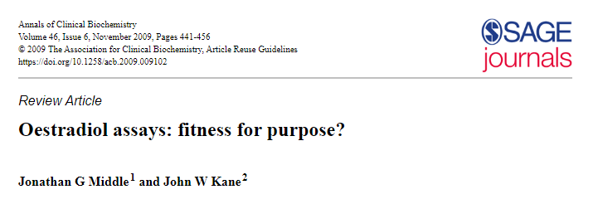
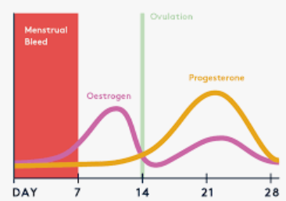
Oestradiol <98 – What Does This Mean?
Current immunoassays cannot detect lower physiological oestradiol concentrations.
The lowest reliable value is 99 pmol/L
A value <98 pmol/L could be anything from 0 to 98 pmol/L
Clinical Significance?

Slide 30
Oestradiol <98 – What Does This Mean?
Measurement of serum oestradiol in isolation is not useful.
Do they have detectable FSH and LH?
What is the clinical picture?
Menstruating?
Or
Amenorrhoeic?
Oestradiol <98
Physiological
Oestradiol <98
Possibly Low

Slide 31
Progesterone
Looking at ovulation
Day 21 progesterone concentrations
Or sample collected 7 days before menses
Progesterone >30 nmol/L ovulation is likely
Progesterone >27 nmol/L is equivocal and ovulation may have occurred
Progesterone 11 to 27 nmol/L ovulation is unlikely – was the peak missed?
Progesterone <10 nmol/L may be consistent with ovarian failure

Slide 32
Biochemistry Tests For Amenorrhoea
All of the above, mostly!
TFTs
LH & FSH
Testosterone, SHBG, FAI
Oestradiol
Prolactin
Differentiating Primary, Secondary and Hypothalamic Amenorrhoea
Case – 41 year old female, secondary amenorrhoea
TSH = 0.9 IU/L
FT4 = 15.2 pmol/L
Prolactin = 142
LH = <1.0 nmol/L
FSH = 3.8 nmol/L
Oestradiol = <98 pmol/L
Testosterone = <0.2 nmol/L
Cortisol = 346 nmol/L
Clinical History
Clinical Examination
Pelvic Ultrasound
? Hypothalamic Cause

Slide 33
Learning Points
Collect male testosterone samples between 08:00 to 10:00.
In hypogonadotrophic hypogonadism is the cause hypothalamic or pituitary? (Seek Endocrinology advice).
A high female testosterone may be due to drugs, HRT or assay interference.
There are lots of causes of a low SHBG and low SHBG concentrations are seen with a normal testosterone.
FSH measurement is not routinely indicated in diagnosing menopause – LH has no role.
Call the Duty Biochemist on 01622 224465 when you need further clinical advice!

